Slide 1
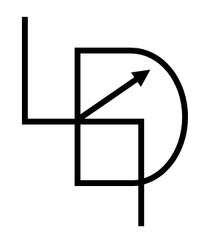
Basics of Python
Smruti Ranjan

Slide 2
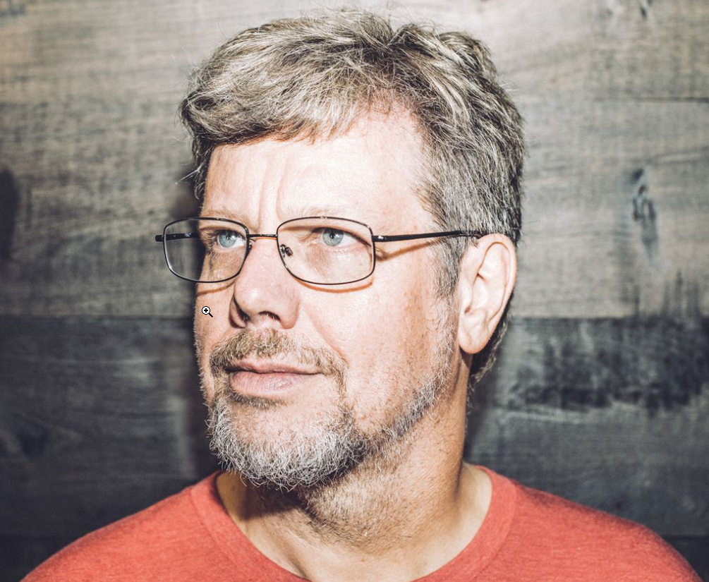
What is Python?
Computer programming language
Created by Guido van Rossum and first released in 1991

Slide 3
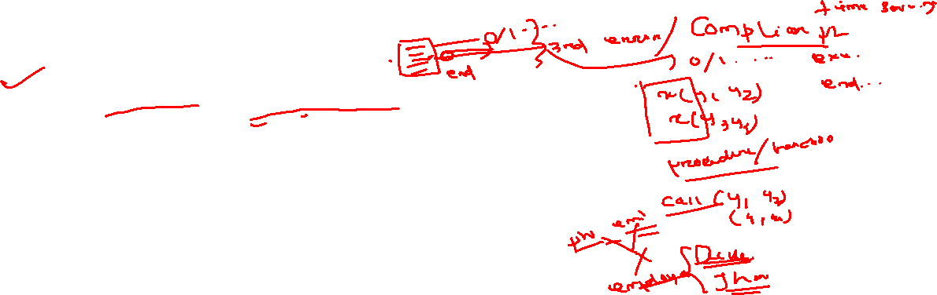
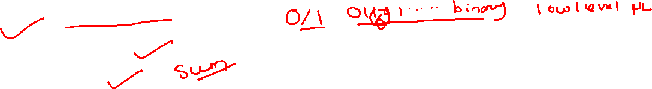
Features of Python
High level programming language
Code readability
Easy to learn
Interpreter programming language
Both procedure & object oriented programming language
Extensibility to other languages
General purpose programming language
A vast user community
Free of cost

Slide 4
Thanks for watching.
Please do like & share this video, and don’t forget to subscribe this channel.
See you next time.
Until then
Cheers!

